Slide 1
MyLegion.org
Online Membership Processing
November 2022
Notes:
MyLegion offers online membership processing for posts, squadrons, detachments and departments.

Slide 2
MEMBERSHIP PROCESSING IMPORTANT INFORMATION
1st transmittal hold
Declined Transmittals
Processing time, 7 business days
$10,000 batch limit
Finalize in 14 days
Transmittal Corrections
Notes:
Important information to know about online membership processing.
<1> Payment information was not converted from the previous interface and must be entered when finalizing the first transmittal, a hold will prevent a 2nd submission until the first transmittal completes. This hold is to ensure payment information in stored correctly and to prevent multiple declines in the event the first transmittal is declined. Finalizing a transmittal prior to the first one completing will result in an error message. This hold is activated each time new bank information is entered.
<2> Declined transmittal will require new bank information to be entered prior to submitting the next batch. If you have repeated attempts, please contact your bank to verify the routing and account numbers.
<3> Current processing time is 7 business days. Unlike the previous version, the new MyLegion will update transmittals once approved by the financial institution.
<4> There is a $10,000 batch limit per transmittal. Amounts higher than that should be broken down to separate transmittals that meet the limit.
<5> Transmittals are to be finalized within 14 days. Members pay their dues with the expectation they will be removed from future renewal notices, receive their membership card in a timely manner, and receive their magazine. When posts do not transmit in the allotted time frame, they run the risk of upsetting their members and making them not want to belong. Open transmittals not submitted in 14 days will receive a reminder to submit and are deleted if no action is taken. All members in the transmittal will have to be re-entered.
<6> Renewing a member for the wrong membership year or any other incorrect transmissions are to be reported to your department. Once a transmittal is in process, it must complete before any adjustments can be made.

Slide 3
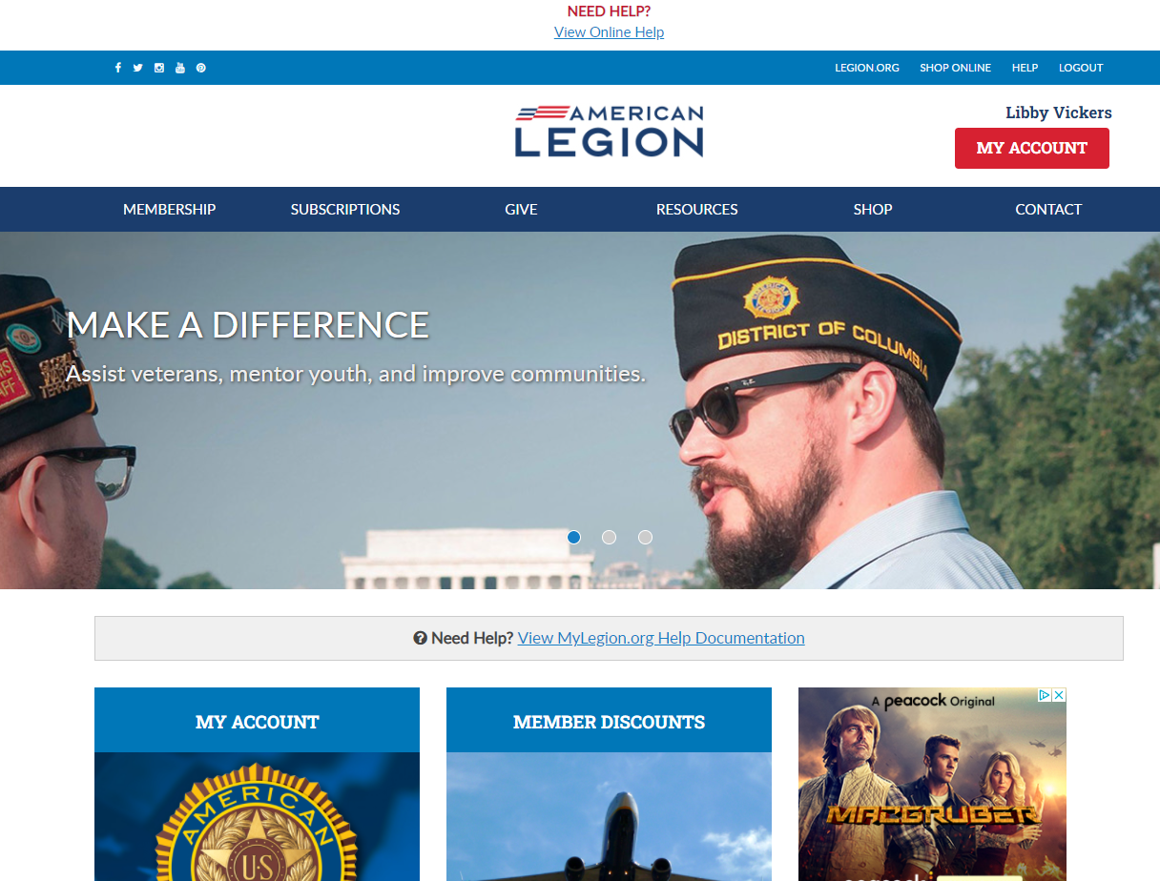
David Sample
Notes:
Logging into MyLegion opens the Home page identifies the member’s name located above the MY ACCOUNT button.
Access to membership processing begins by clicking on My Account.

Slide 4
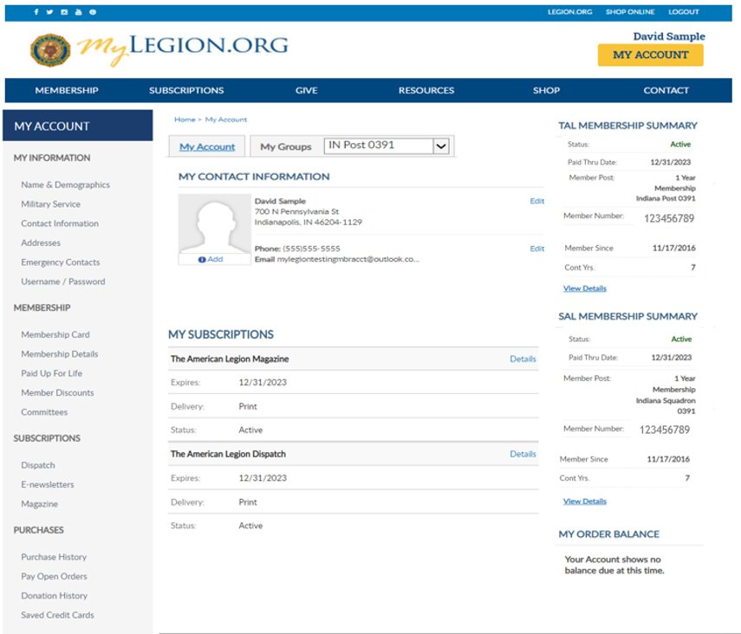
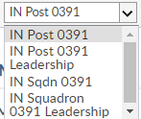
Notes:
Membership processing is available to adjutants and commanders through their individual accounts. My Groups is the administrative side of myLegion. <1> If you do not have a My Groups menu and are a post or squadron adjutant or commander, contact your department or national headquarters.
This member is a post adjutant. Post adjutants and commanders have access to both post and squadron membership and leadership groups. <2>
Clicking on the group will navigate you to the administrative side of MyLegion. Please watch for the spinner indicating the page is loading.
Create a transmittal by first going to the group. Select Post. <3>
To create a squadron transmittal the group to select is Squadron. <4>

Slide 5
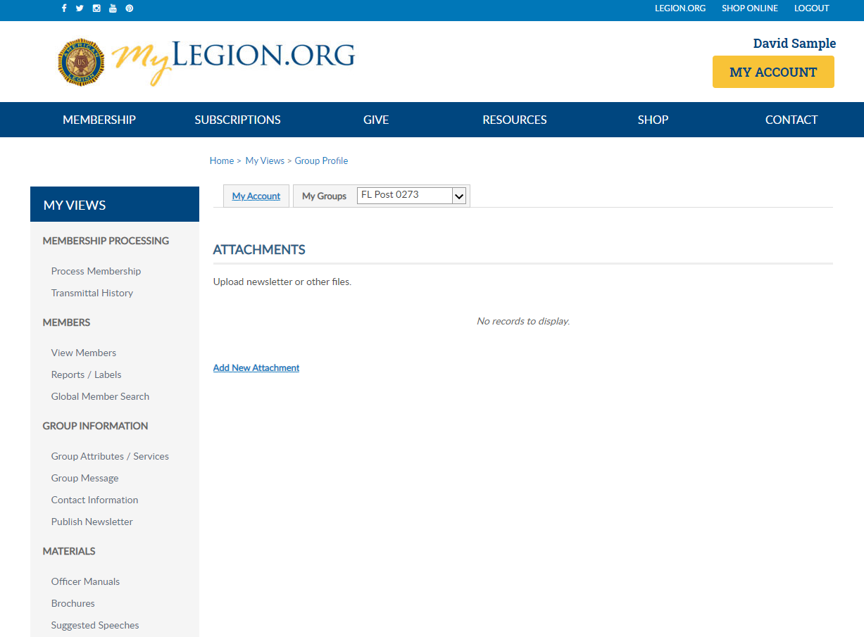
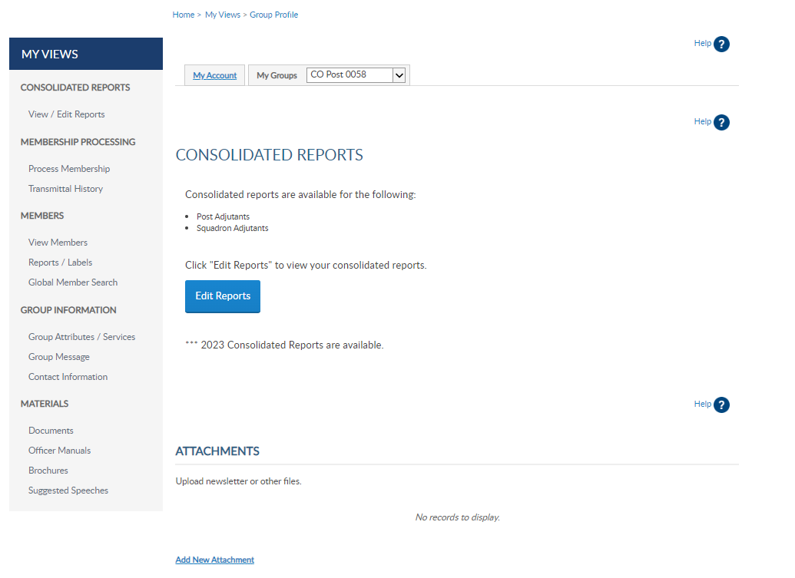
David Sample
Notes:
Transitioning to the administrative side of MyLegion provides a left menu provides an option for Process Membership. You can also access membership processing through View Members.

Slide 6
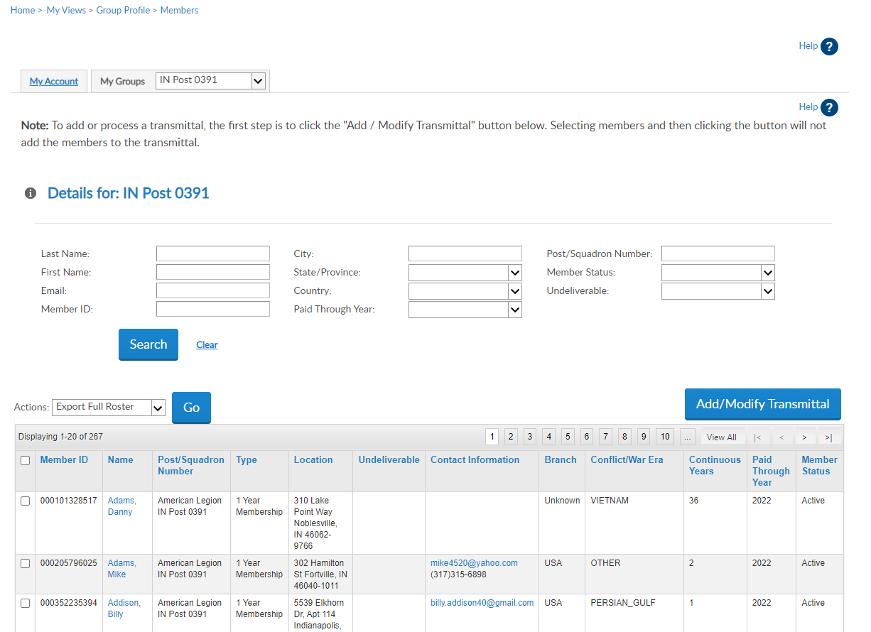
View Members
Notes:
The member list includes all members with a last paid years for current and expired members. <1> Notice in this listing we are viewing the far-right column displays the Paid Through Year. Members paid for the current year are not eligible for renewal.
To learn more about the View Members grid, refer to Group Administrative Tasks located in MyLegion Resources. Do not check names in view members to renew. The checkboxes in view members is for export purposes does not add members to a transmittal batch.
Create a new transmittal or edit an open batch with Add/Modify Transmittal. <2>

Slide 7
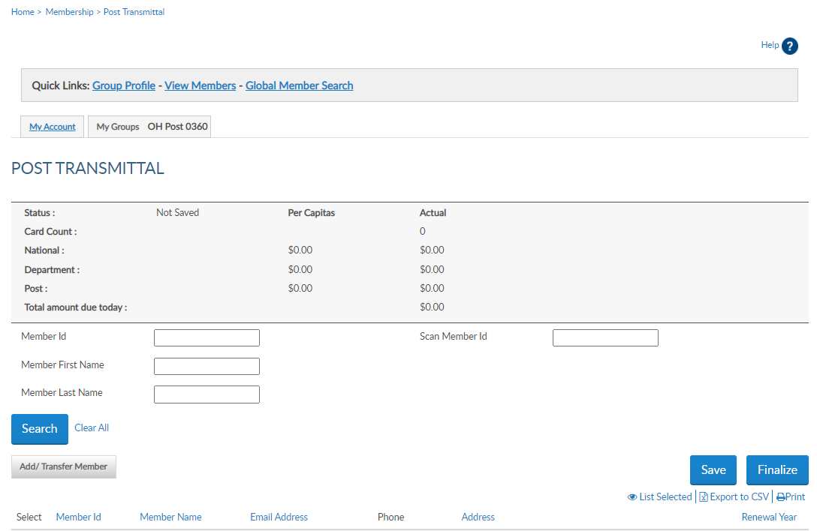
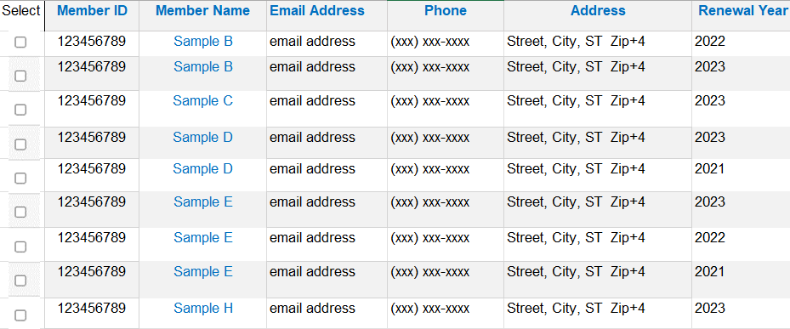
Transmittal Summary
Notes:
The transmittal page displays a summary <1> that includes transmittal status, number of cards, and per capita allocations. Total amount includes national and department only. These amounts do not display until a member is added to the batch, The summary area recalculates with each entry.

Slide 8
Search
Notes:
Search fields allow you to quickly find a member by ID, or name.

Slide 9
Transmittal List
Notes:
<1> The listing in post transmittal only displays names of members eligible for renewal. Members with more than one eligible renewal year will have 2 lines as in Sample B. The renewal year column is the year of renewal. Current paid members will not display in this listing.
If you do not find the member to renew, the member is either already paid, in a pending transmittal, transferred out of your post, or expired for greater than 2 years. Tools available to determine the members status are located in Transmittal History, Current Roster, and Roster Updates.
Let’s begin with a renewal.

Slide 10
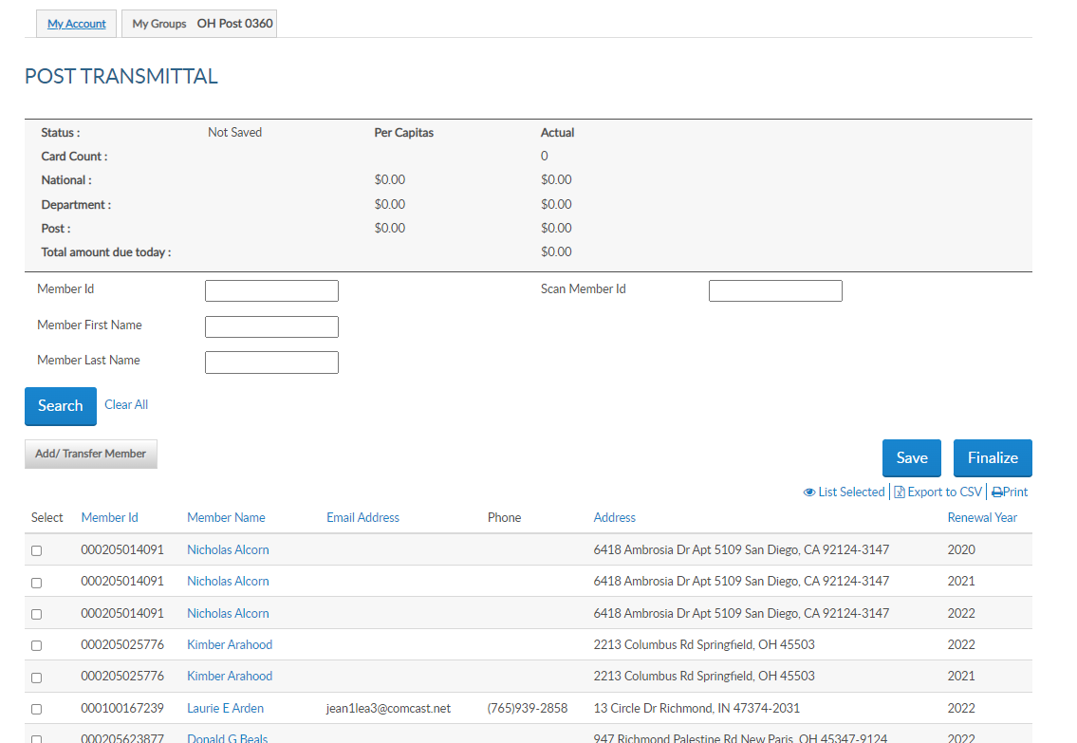
Renew
Notes:
Search the member by name or ID# and click in the box left to their name for the renewal year. <1> A member can have more than one renewal year. Sample B is eligible to renew for multiple renewal years. Be cautious to select the correct year. More than one can be processed in the same batch. Checking the box adds the member to the batch and the summary re-calculates.
The scan member ID field is for departments and large posts using bar code scanners. This allows you to scan the barcode from the membership card to auto enter in the field. The 'Scan Member Id' box only applies to the current membership year. You don't have to use a scanner to utilize the "Scan Member Id" box; you can just type the ID and hit enter and it will add the member to the transmittal.
The total amount due equals the department and national per capita only. <2>
The Save button <3> allows the transmittal to be saved and finalized on a later date. Exiting this area without saving the batch will result in having to re-enter any entries made. Save each entry as you go and when all names are added finalize the batch.

Slide 11
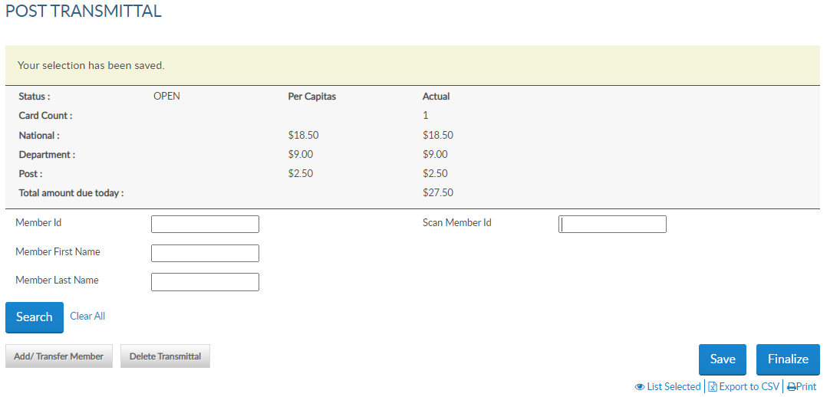
Add New Member
Notes:
After saving the transmittal the status becomes open and a delete transmittal button appears. You can delete this transmittal up to finalizing with payment information. Save each entry to prevent losing members in the batch.
<1>Add a new member or transfer a member using the Add/Transfer Member button. <2> Let’s add a new member to the batch.

Slide 12
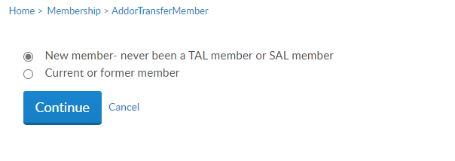
Add New Member
Notes:
Select “new member – never been an American Legion or Sons of the American Legion member.

Slide 13
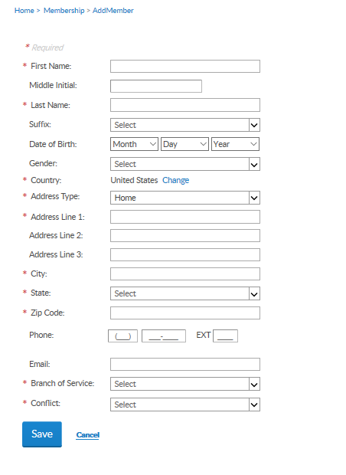
Address Error?
www.zip-codes.com/state/va.asp or
https://tools.usps.com/go/ZipAction_input
Member is expired.
Member belongs another post/squadron.
Individual create an account prior to joining and was assigned this ID. No membership details are attached.
Notes:
When adding a new member, enter contact and military information and Save. <1> Fields with an asterisk are required. To enter a foreign address, use the pulldown menu to select the appropriate option.
<2> If you receive an error message about invalid city, state or zip please use zip code verification from the United States Postal Service to verify the correct information. Entries that do not meet USPS standards will receive an error.
An error message <3> “A Customer exists with matching details with the member ID#” is generally due to the following reasons:
<4> The member is expired and not included in the post transmittal list, <5> or the member is a member of another post or squadron.
<6> The individual may have created a MyLegion account prior to joining. This ID# will not change and become the individual’s permanent membership ID#.
In all these cases, make note of the member ID# in the message. Click cancel to return to post transmittal and process as current or former member.

Slide 14
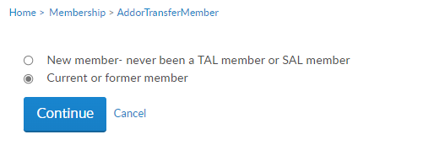
Creating Dual Members
Notes:
Dual membership are members that hold current membership for both The American Legion and Sons of The American Legion. To add a Son’s member who is currently an existing Legion member begin in the Squadron group. <1> Go to Add/Transfer member <2> and select current or former member. Dual members will have the same membership ID#. Through this process you will enter the member’s Legion D#, last name.

Slide 15
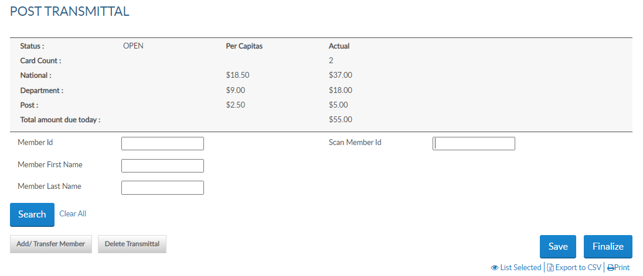
Transfer
Notes:
The summary recalculates after adding members to the batch. <1>
View the members in the batch using the List Selected Icon. <2>
<3> To transfer a renewing member, select Add/Transfer Member. Only members that are renewing dues can be transferred online. To transfer paid members, complete a Member Data Form and send to your department.

Slide 16
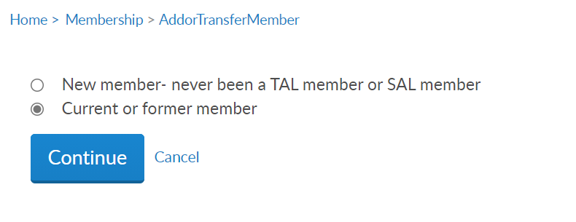
Transfer Member Member must renew in same transaction
Notes:
Payment must be processed with the online transfers. Current members that request a transfer are submitted to your department headquarters using the Member Data Form.
Select current or former member and continue.

Slide 17
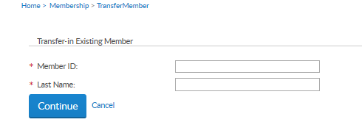
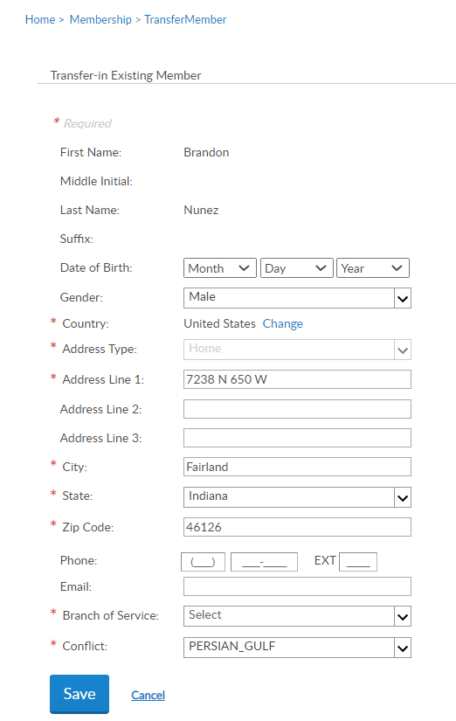
Member First Name
Member Last Name
Member Address Info
Saves member to the transmittal.
Notes:
Enter the member ID# and last name.
Update any information needed and Save. This saves the member to the batch.

Slide 18
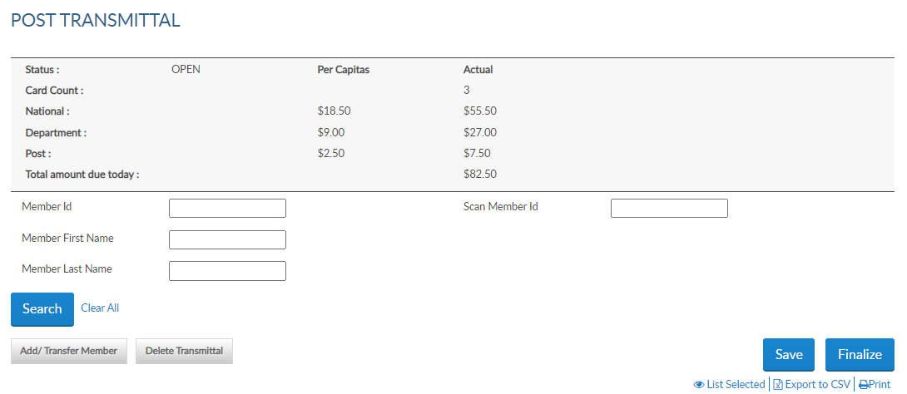
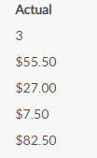
Notes:
The Summary recalculates with the amount due.
To remove members from the transmittal, uncheck the box next to the name. To delete the whole transmittal, select “Delete Transmittal”. <1>

Slide 19
Notes:
After all names are entered, finalize the batch. Payment information will be entered during finalization if not already stored.
<1> Select Finalize. This brings up a window listing all the names and renewal years in the batch.

Slide 20
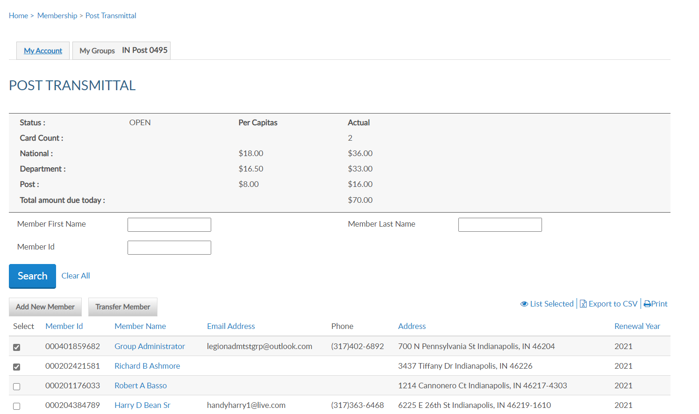
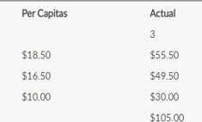
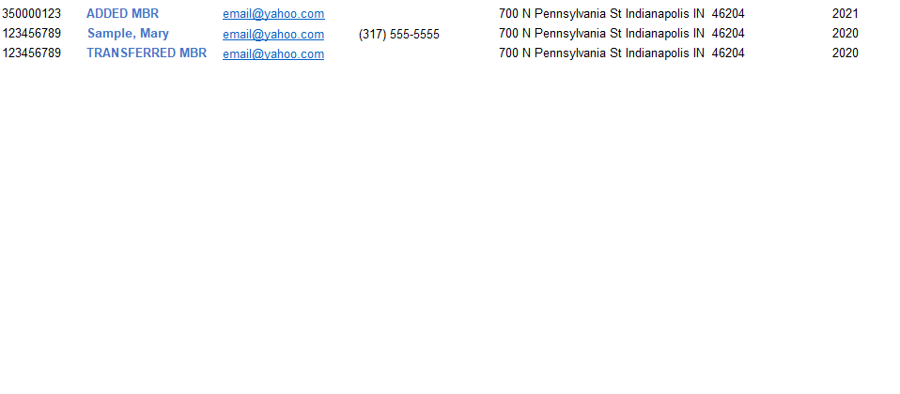
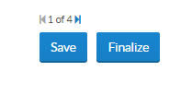
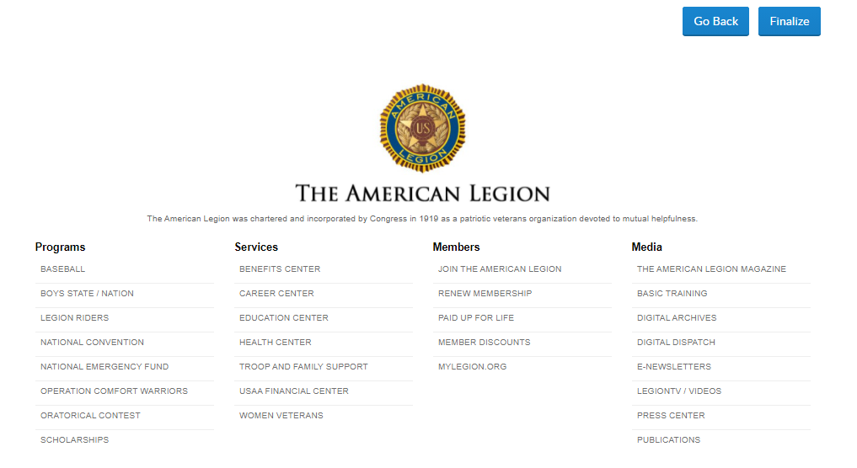
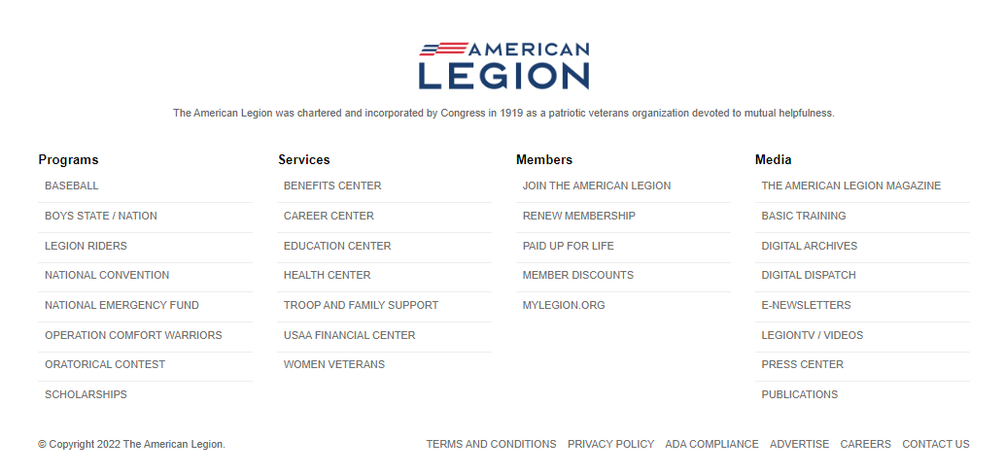
Membership Processing MEMBERSHIP > POST TRANSMITTAL
New Member
Sample, B.
Transfer Mbr
2023
2023
2023
Notes:
Selecting finalize displays the members in the batch. Click finalize to continue.

Slide 21
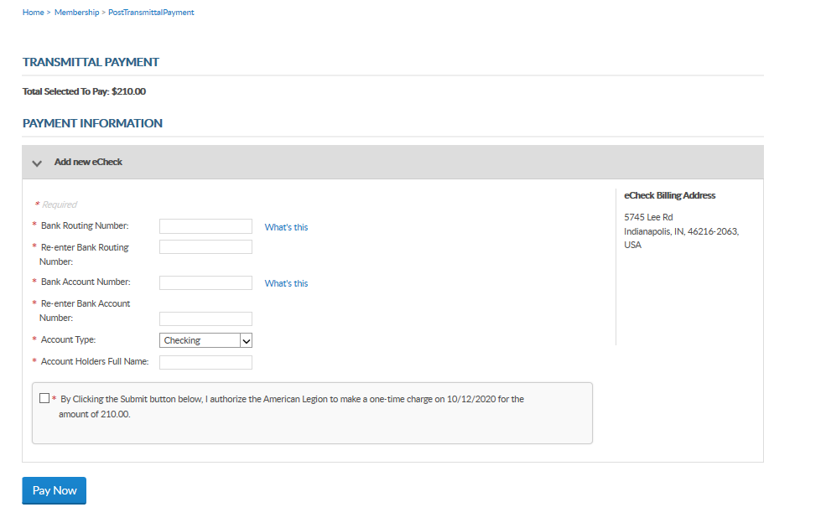
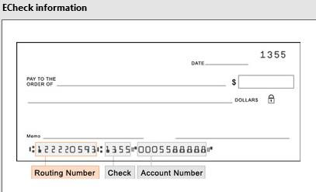
Membership Processing MEMBERSHIP > POST TRANSMITTAL PAYMENT
$82.50
By Clicking the Submit button below, I authorize the American Legion to make a one-time charge on 11/1/2022 in the amount of $82.50
Notes:
Payment information must be entered when finalizing your first transmittal. Enter the routing and bank account information. The Account Holder’s name is the name of the post or squadron bank account. When entering, use a specific description instead of a generic name as in American Legion Post 1.
<1> The easiest place to find your bank’s routing number is to look at your paper checks. The check will typically have the 9-digit routing number down on the bottom left of the check. All routing numbers are 9 digits.
Foreign posts and squadrons can process membership with a credit card. Online membership processing is designed for payment to be processed with a post or squadron account and not with individual credit cards.
The only payment method for US posts is eCheck. Enter the bank account information, authorize the one-time charge by clicking the checkbox and Pay Now.
This information will be stored for future transmittals. Entering new payment information holds future transmittal from finalizing until the first transmittal completes. This is to ensure all subsequent transmittals have valid bank information.
If you receive an error when entering payment information, contact your financial institution to verify ACH payment account information.

Slide 22
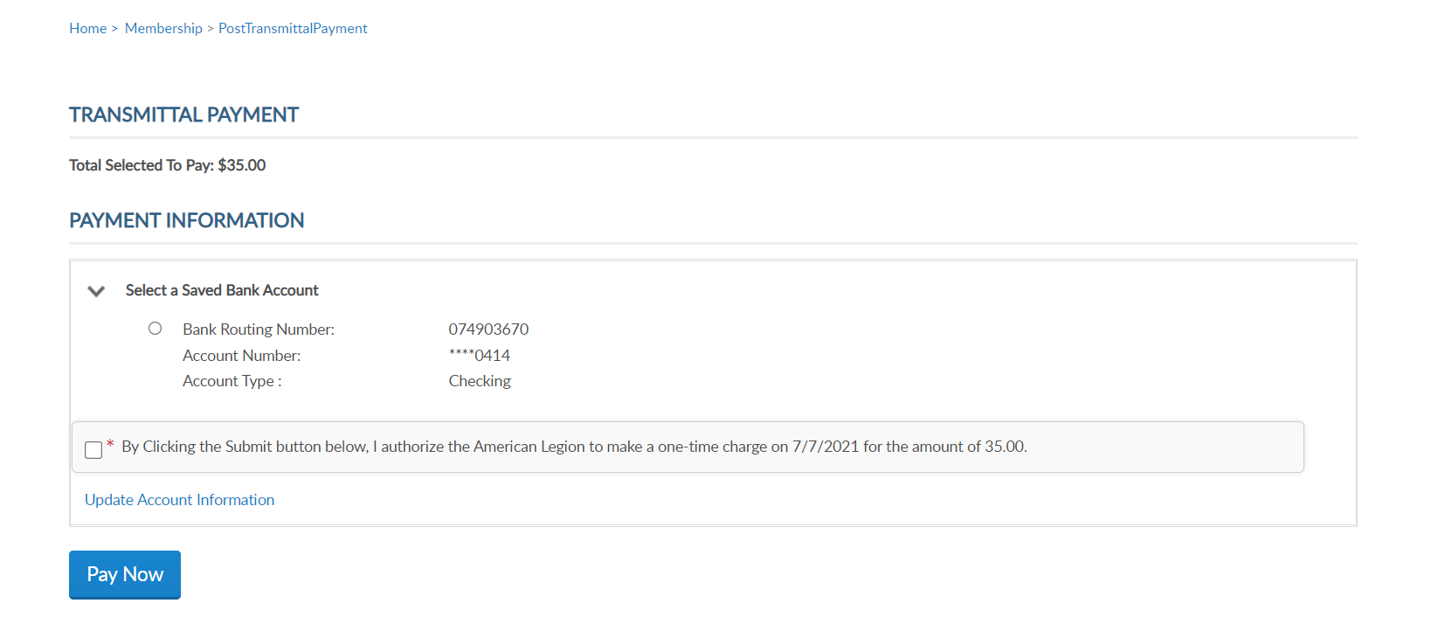
Membership Processing MEMBERSHIP > POST TRANSMITTAL PAYMENT
$82.50
By Clicking the Submit button below, I authorize the American Legion to make a one-time charge on 11/1/2022 in the amount of $82.50
Notes:
The next time a transmittal is finalized, the information is stored. With each transmittal you must select the buttons to authorize the payment and hit Pay Now.

Slide 23
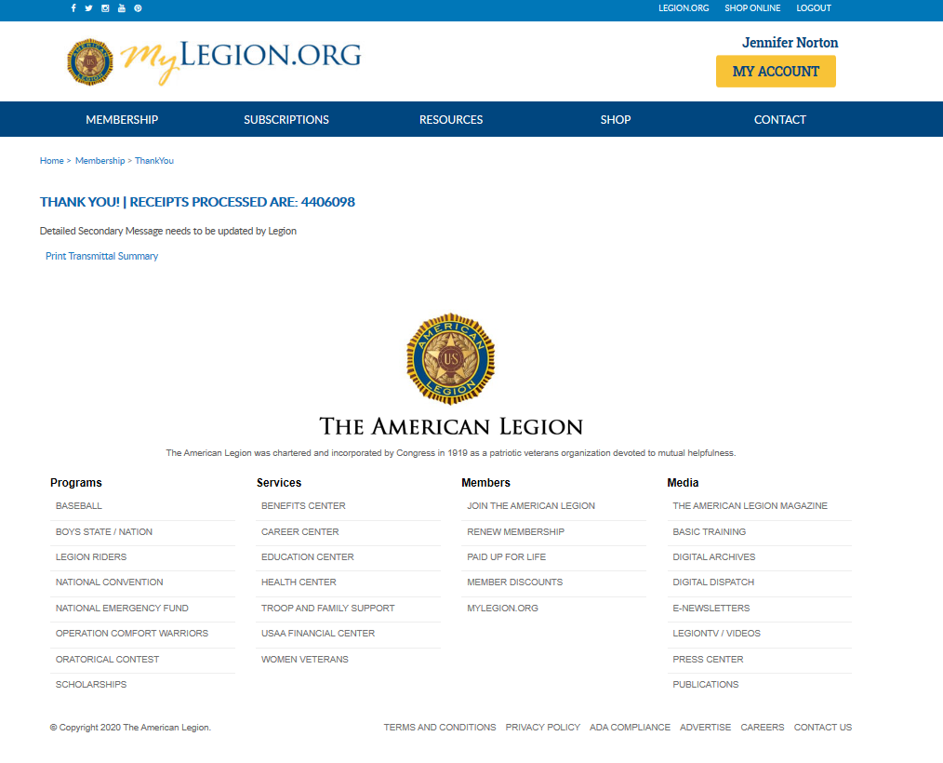
David Sample
Notes:
Finalization of a transmittal produces a receipt number. This is notification the transmittal has been received and is in process. While in pending status, counts are added to the National Target Date membership reports and are immediately available for Departments to add to their membership reports. Legion members do not receive renewal notices and it prevents them from renewing online that creates duplicate payments.
To view the transmittal summary, and print the receipt, click Print Transmittal Summary.

Slide 24
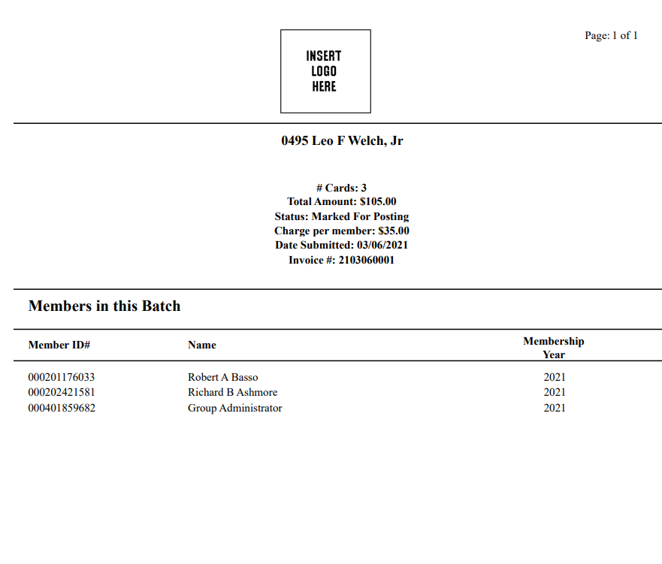
IN Post 0391 Legal Name
# Cards: 3
Total Amount: $82.50
Status: Marked For Posting
Charge per member: $27.50
Date Submitted: 11/01/2022
Invoice #: 2110036001
07/01/2021
123456789 B. Sample (Renewal) 2020
123456789 New Member Name 2021
123456789 Transfer Member Name 2021
2023
2023
2023
Notes:
Print or Save this document for your records. This information is also available in your transmittal history.

Slide 25
Update payment information
$82.50
By Clicking the Submit button below, I authorize the American Legion to make a one-time charge on 11/1/2022 in the amount of $82.50
Notes:
Stored bank information can be updated. This is done when finalizing the next batch. <1> Click the link to Update Account Information to re-enter.

Slide 26
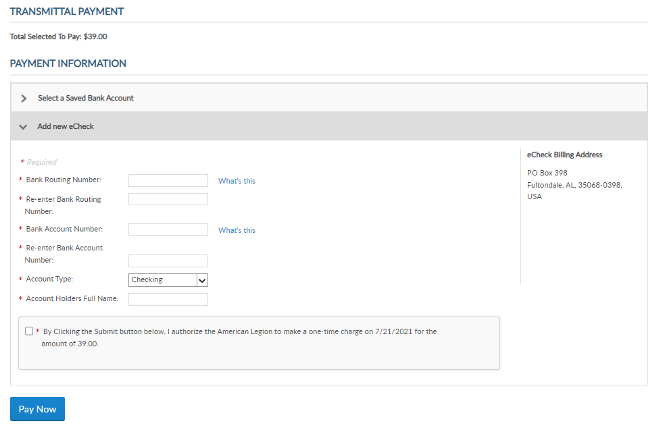
Update payment information
$82.50
By Clicking the Submit button below, I authorize the American Legion to make a one-time charge on 11/1/2022 in the amount of $82.50
Notes:
Enter the new bank information and Pay Now. This will replace the current payment information on file.

Slide 27
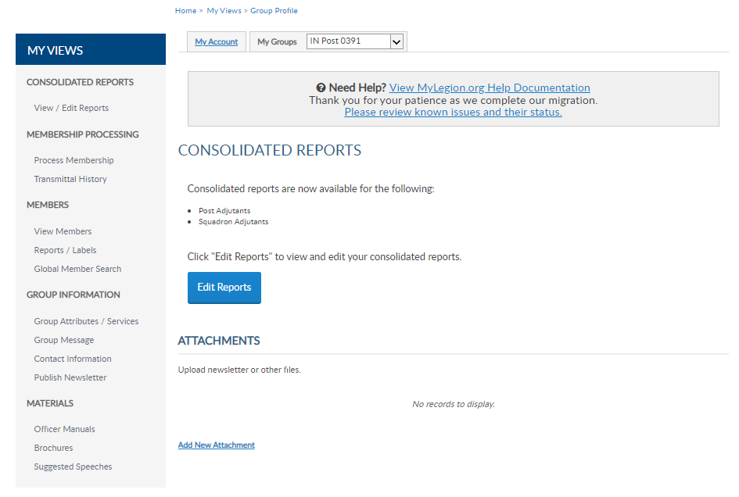
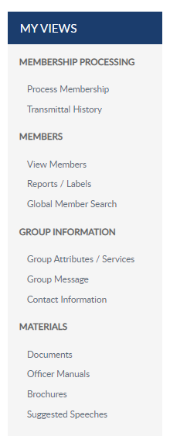
David Sample
Notes:
Transmittal History is located in the left menu of your group profile.

Slide 28
Transmittal History
3 $82.50
2208300129 Multiple 10/15/2022 Online 2022-10-25 0 $0.00 3 $82.50
2022
2021-07-01
2209030391 2023 11/101/2022 Online IN PROCESS 0 $0.00 3 $82.50
Online transmittal history prior to April 1, 2021 will be available for review.
Notes:
Transmittal history includes reference number, membership year, status, actual number of members submitted and total amount.
<1> Using the Range search field, you can alter the history displayed. Custom range <2> pulls up date field to set the range of history to be displayed. Online transmittal history is only available from April 1, 2021 to current.

Slide 29
IN Post 0391 Legal Name
# Cards: 3
Total Amount: $82.50
Status: Marked For Posting
Charge per member: $27.50
Date Submitted: 11/01/2022
Invoice #: 2209030391
123456789 A. Sample (Renewal) 2023
123456789 New Member Name 2023
123456789 Transfer Member Name 2023
2022
2022
2022
Notes:
Clicking on the transmittal number opens details including members in the batch, amount and status.

Slide 30
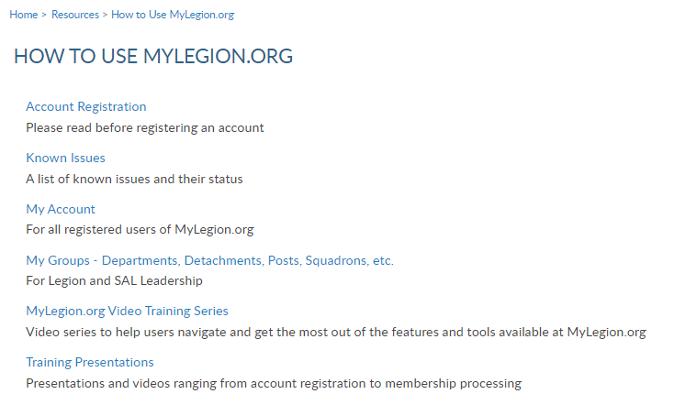
Online Help
Notes:
Online help is available from the Resources Menu.
Step by step instructions, videos and training presentations will assist with how to renew, add and transfer members.

Slide 31
mylegion@legion.org
833.253.9995

